Slide 1
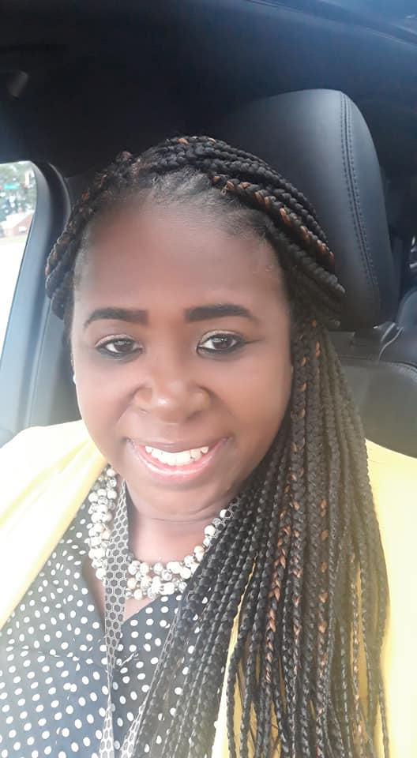
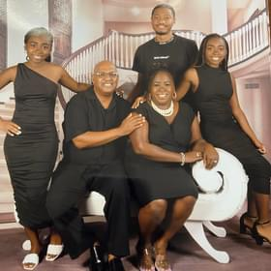
Meet Your
MTSS Facilitator
Mrs. Lorie Bennett
My name is Mrs. Lorie Bennett and I am the Multi-Tiered System of Support (MTSS) Facilitator for Gracewood. This is my 17th year in education and my first year as MTSS Facilitator. I am a proud combat veteran of the United States Army. I am a graduate of Voorhees College/2002, BA, Organizational Management; Augusta University/2008 ,Masters in Teaching; Augusta University/2020. ED.S, Advanced Educational Studies.
Contact Me:
Phone Number:
(706)796-4969
Email: bennelo@rcboe.Richmond.k12.ga.us

